Slide 1
Custom permissions

Slide 2
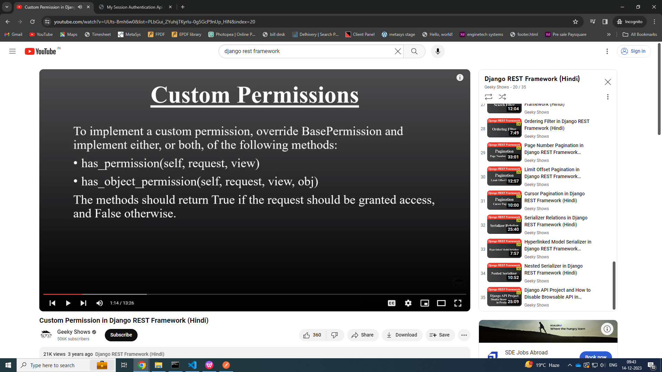

Slide 3
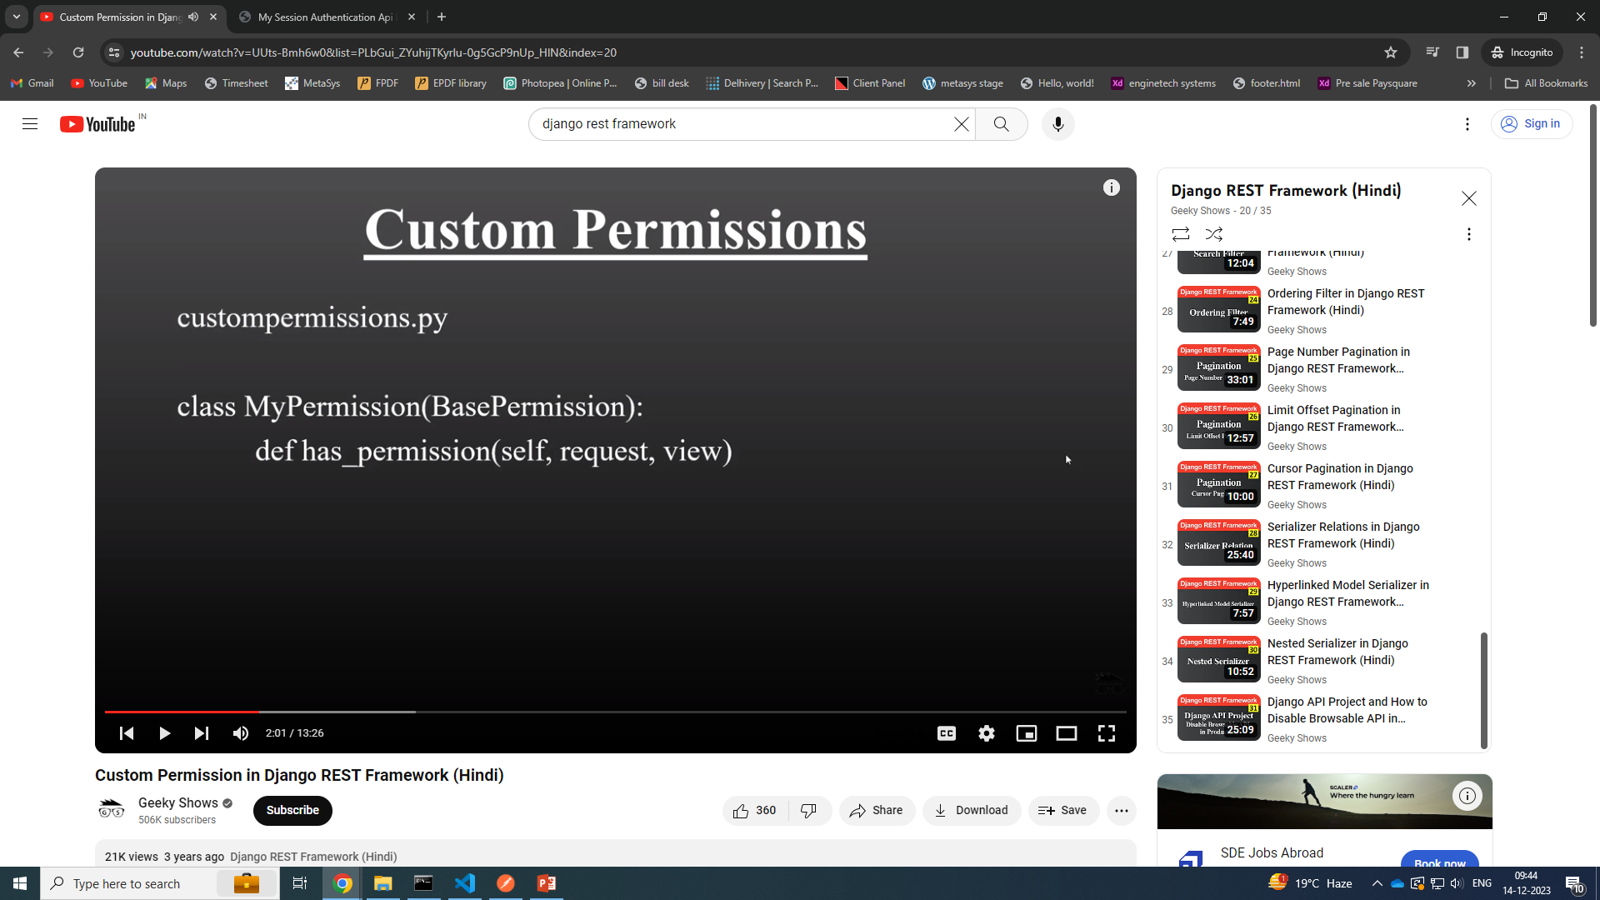

Slide 4
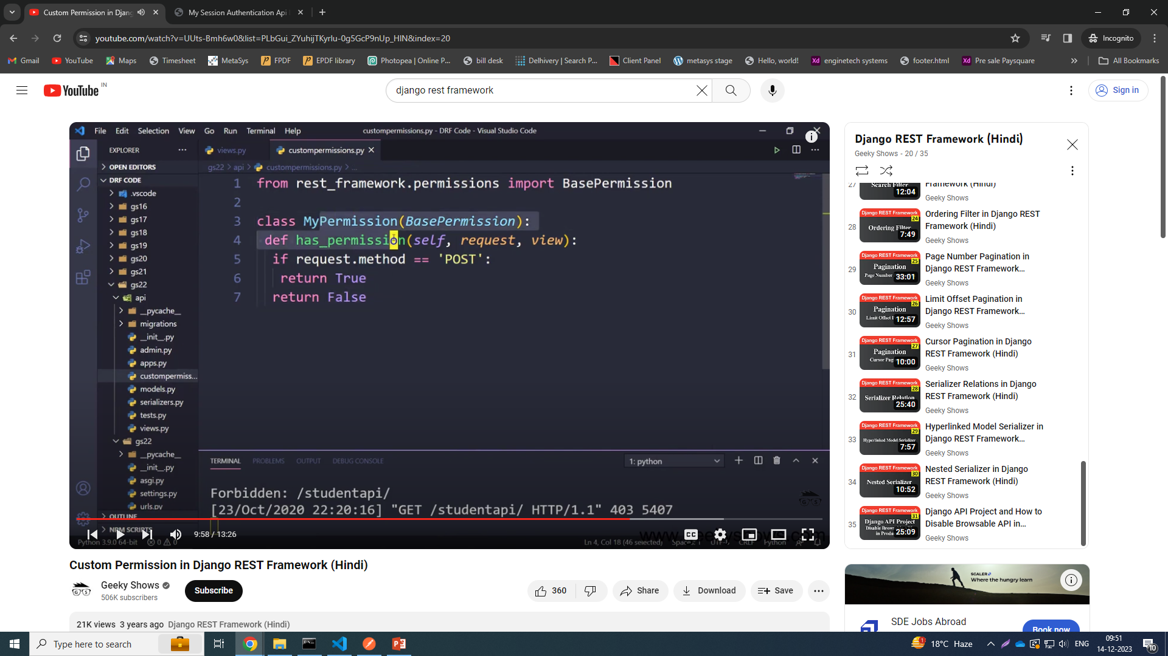

Slide 5
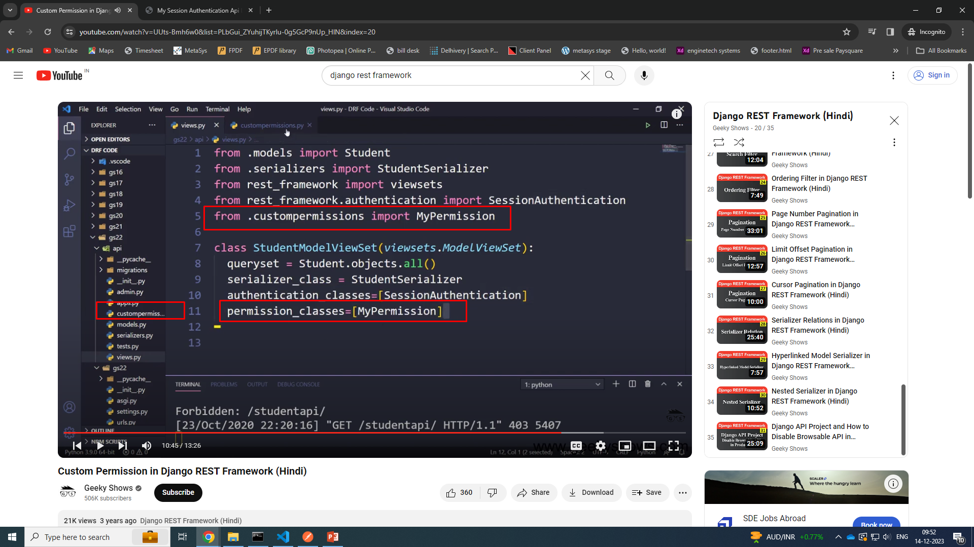

Slide 6
Customepermissions.py
from rest_framework.permissions import BasePermission
class myBasePermission(BasePermission):
def has_permission(self,request,view):
if request.method == "GET":
return True
elif request.method == "POST":
return True
else:
return False

Slide 7
Views.py
from django.shortcuts import render
from django.http import HttpResponse
from rest_framework.parsers import JSONParser
from rest_framework.renderers import JSONRenderer
from .models import Location
from .serializer import LocationSerializer
# Create your views here.
from rest_framework.response import Response
from rest_framework import status, viewsets
from rest_framework.authentication import BasicAuthentication, SessionAuthentication
from rest_framework.permissions import IsAuthenticated, IsAuthenticatedOrReadOnly
from .custompermissions import myBasePermission

Slide 8
Views.py
# custom permissions
class myCustomPermissionApi(viewsets.ModelViewSet):
queryset = Location.objects.all()
serializer_class = LocationSerializer
authentication_classes = [SessionAuthentication]
permission_classes = [myBasePermission]

